Slide 1

PROJECT ON WEATHER APP
PROJECT GUIDE : SOUMYA BHATTACHARYA
TEAM MEMBERS :
1.SURYAKANTA MAZUMDER430416010057
2.PARTHA GHOSH 430416010026
3.INDRANI BARDHAN 430416020018
4.SANCHARI ROY 430416020036
5.SARBANI MUKHERJEE 430416010038

Slide 2
AUTHENTICATION
I Sanchari Roy hereby declare that the project on WEATHER APP has been carried out in the practical laboratory of Department of Information Technology in NIT under the guidance of Sir Soumya Bhattacharyya. I also declare this project work has not been submitted anywhere for fulfilment of a course of study to the best of our knowledge.
SANCHARI ROY
MR. SOUMYA BHATTACHARYYA

Slide 3
ACKNOWLEDGEMENT
First I owe to express our almighty “GOD” for his inherent inspiration and being with us through out this venture.
No words can contain and convey my intense feeling of dedication, earnestness and gratitude of my learned guide Mr. Soumya Bhattacharyya, whose perpetual guidance, encouragement and willingness to help promoted me to steer clear through this Project. I would like to express my humble regards to him for providing us with full support, cooperation and his invaluable time with us. We got a very nice learning experience and learnt a lot under his guidance.
We humbly express our deep sense of guidance to Mr. Soumya Bhattacharyya for helping us by showing simplified way out during many difficult situations which we had faced during the preparation of this Project and also not out of phase to thank some of our good friends who shared their knowledge in some of the tough situations with us. We render our deep sense of guidance to our beloved parents for their constant encouragement , timely assistance, dedication, inspiration, moral support and silence presence throughout the work.
THANKING YOU ALL,
DEPARTMENT OF INFORMATION TECHNOLOGY

Slide 4
PREFACE
In the Project of “WEATHER APP” we have arranged the piece of code into three different sections by using HTML, CSS and JAVASCRIPT in a very simplified manner. The main objective of this Project is to detect the weather forecasts of any cities instantly through this application. Forecasts are given for the present and the following day, textually and in picture format. User friendliness is the aim of the project. It is hoped that this project will be useful for the user.
DEPARTMENT OF
INFORMATION TECHNOLOGY

Slide 5
TABLE OF CONTENTS
SLIDE NO. | TOPIC
7 | Project Overview Statement
8 | Needs OF Weather App
9 | Faults Of Exixting Apps
10 | Design
11 | Img : Front page Layout
12 | Img : Search Result(1)
13 | Img : Search Result(2)
14 | Introduction
15 | Languages Used
16 | Step-1 The Setup
17 | Step-2 HTML
18 | Step-3 CSS
19 | Step-4 JAVA SCRIPT
20 | Step-5 The API
21 | Step-6 The Data

Slide 6
SLIDE NO. | TOPIC
21 | Adv. Of This Device

Slide 7
WEATHER APP
Project Overview Statement(POS)
PROJECT TITLE | WEATHER APP
PROJECT LEADER | SURYAKANTA MAZUMDER
DEPARTMENT | INFORMATION TECHNOLOGY
PROJECT ID
PROJECT DEADLINE
The Project on Weather App is basically an app that displayed the weather wherever the user happened to be. User can view the weather in their current location and also can toggle the temperature unit and thus weather icon or background image will change depending on weather conditions. This project is user friendly and so user can search for weather information of other places too. We had a bunch of ideas for the design of this app and we did look at a few completed projects (without checking their code, of course) from the community to see what other folks were displaying in their app and how it looked.
Coming up with a final layout was a bit tricky but we found it helpful to decide the elements we wanted to display for the user and build from there.
Keeping things simple was the aim here. We decided to show only the temperature and weather description in addition to the local time.

Slide 8
Needs of Weather App:
To plan journey ahead accordingly.
To know when its going to rain or going to be cloudy.
A person travelling in a bus/train etc. might need to know the weather of destination city.
Sometimes travellers may need to know more details about the weather like visibility, fog, humidity etc.
To plan meetings/commute timings

Slide 9
Existing Apps..
Beore starting this project, I went through some of the existing weather apps like Yahoo weather, Default iOS weather app, Solar etc. and found that all of those have one or more the following problems.
1. Information Overload : Too much of extra unnecessary information
2. Not Intuitive : Some apps are beautifully designed but are not intuitive to use
3. Too less information
4. Complex interactions : Multi-touch gestures, mix of horizontle and verticle scrolling just to access simple informations were seen in few apps, thus making them non user friendly
So, keeping in mind these drawbacks we have designed this Weather application project. This is compact, informative and user friendly too.

Slide 10
Design
Headline at the top
Background image under the headline
The current local temperature will be displayed in Celsius
Along with the local temperature, local time and weather description will also be displayed.
A search box will be present for searching the weather for other locations
Behavior
The page will ask for access to the user’s location on load to update weather information.
As soon as the page is refreshed after searching the background image will set to default image.
The animated weather image will change according to the climatic condition of the respective locations.

Slide 11
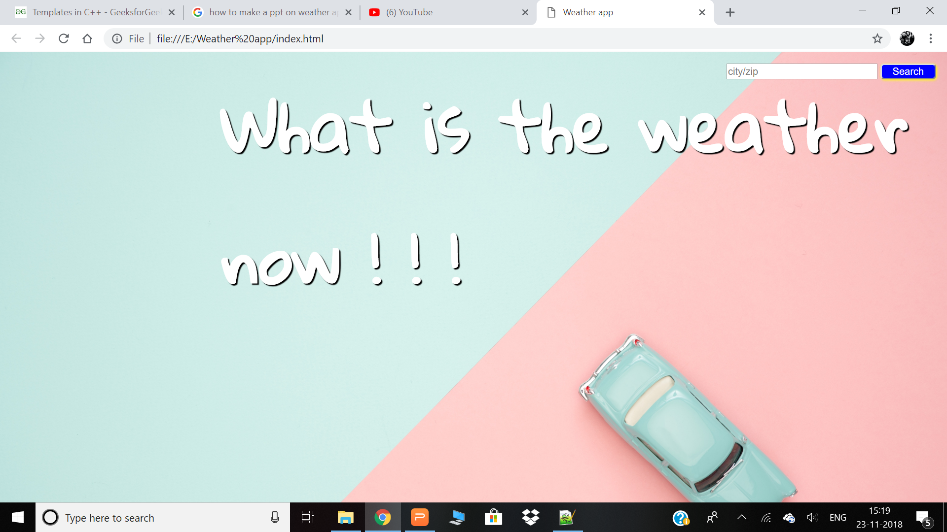
This is the layout of the start page :

Slide 12
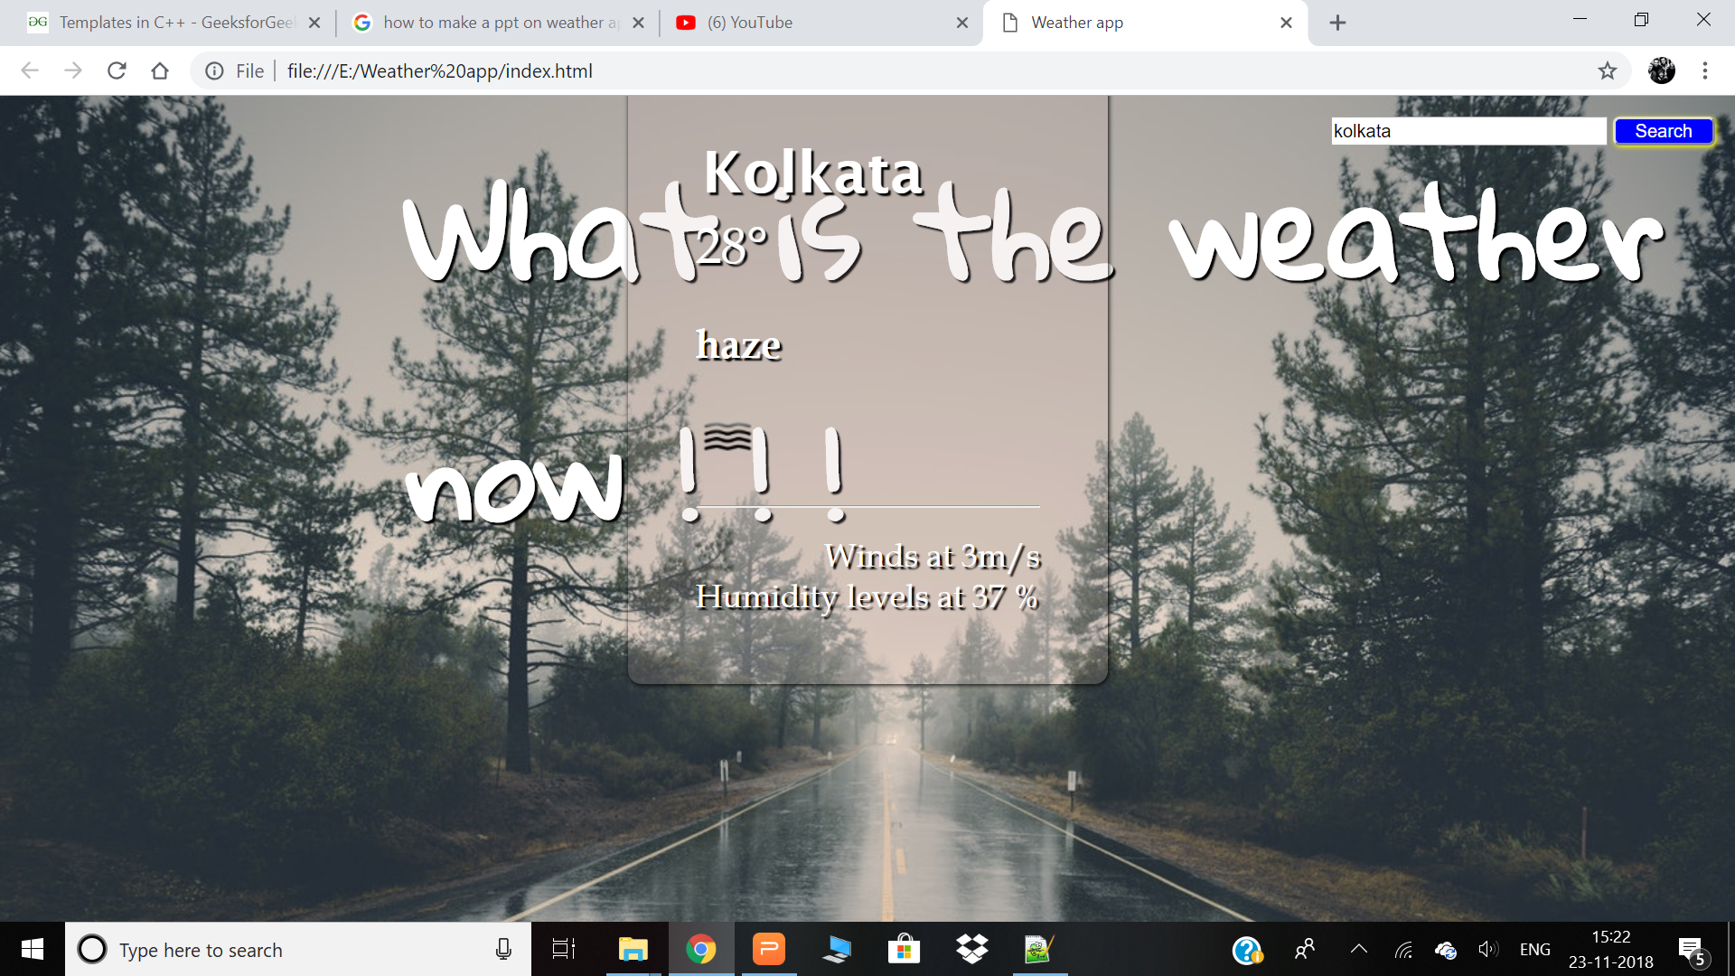
After entering a city in search bar the page shows this layout :

Slide 13
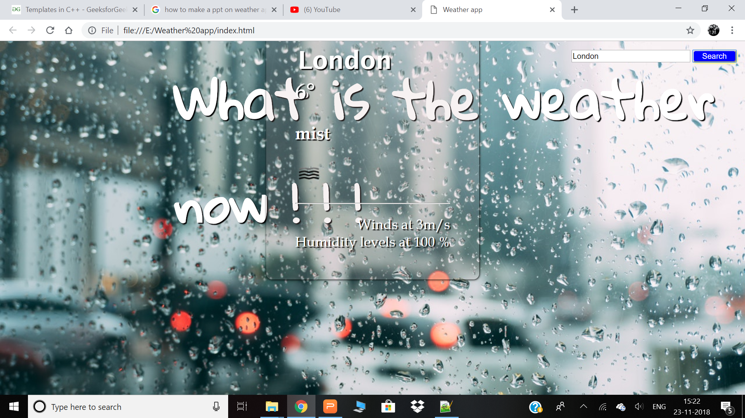

Slide 14
Introduction
The easiest way to do this was to use the HTML Geolocation API which was pretty straightforward it had already been covered it in the JSON and APIs section of the curriculum. The Open Weather API gave us a way to update the location, temperature and weather description but we still needed to find a way to update the local time.
The last thing we did was to update the weather icon on the conditions in the user’s location or city of interest. We decided a good way to do this was to check the weather description and change the icon based on that. So we considered a few possible scenarios such as clear sky, cloud, snow, sunny, rain etc. and wrote a bunch of conditional statements to check if the weather description contained one of keywords and then update the weather icon.

Slide 15
The main ingredients required to build this application are :
HTML – the information represented on the page.
CSS – the style or look of the information.
JAVASCRIPT – the programming language needed to add the necessary behavior (or interaction) to the webpage.
API (Application Programming Interface) - where and how we get the weather data.
JSON - the weather data.
jQuery - a JavaScript library that makes web programming a bit easier for us.
The main goal of this project is to build an application consisting of an .html file, a .css file, and a .js file that will run in a browser. For building this project we need a text editor to write our application. Better than a text editor, what we really want is an IDE, an Integrated Development Environment. This is a text editor that has some extra bells and whistles that will make our development lives much easier.

Slide 16
Step 1 – The setup
First we'll make a .html file - HTML is the "info" or content that goes on the page. It stands for Hyper Text Markup Language. This page will designate everything we have and need for our application to run in a browser, including other files. Next, the .css file - This is where we designate the style or look of the content. CSS stands for Cascading Style Sheets, which basically means if there are styles of "equal importance", the last one to be defined will be the one that gets applied. And the .js file - This will handle the "behavior" of our application. A majority, if not all, of our "interactivity" logic will go here.
Our application consists of three main files - (1)an HTML file, (2)a CSS file, and (3)a JavaScript file and we are going to use a web API that will help us obtain data. The data will come in via the web in a format called JSON. We can use that data in our application.

Slide 17
Step 2 - HTML
We added some 'markup' to our HTML page. Once the markup is being added the file is opened in the browser. Now you can open the file in the browser by double-clicking the file or control-clicking the file and select "Open With" and your browser of choice. We'll be using Google Chrome. Once it opens, you should see the "content" of your markup rendered on a web page.

Slide 18
Step 3 - CSS
Now that our initial page is complete, we can add some basic styling to make it look better. We do this in our .css file. After adding some CSS markup, refresh the browser page and you should see the styles added to the presentation of the content. We can explore the Developer Tools in the browser to help with our styling.

Slide 19
Step 4 - JavaScript
Now that we have a page that looks semi-presentable, it’s time to add in the necessary interactivity. To do this, we’ll need to write some code and we’re going to write it in JavaScript. JavaScript is the language of the web, it comes installed in the browser, and it’s well suited to event-based asynchronous interactions. We can write JavaScript code directly in the ‘console’. The browser also creates some variables for us, one of which is the document. The document variable has all the markup information from the .html file, which is great.

Slide 20
Step 5 – The API
The Open Weather API is a service that lets us use the world wide web to 'ask for' or 'get' (also known as a 'Request') and 'receive' (also known as a 'Response') up-to-the-minute weather information. API - stands for Application Programming Interface, which is a way for one application to speak to another APIs exist all over. For this lesson, we'll think of APIs as "public web URLs that return data". What does that mean? Well, with most URLs we visiting, like http://google.com, we expect the browser to show us a web site designed for a person to use. But, there are other URLs that just show raw data on the page. Why? Because, the browser will display whatever file response comes from the server. Usually, that's an HTML file, but for Web APIs it's something else, usually json or xml.

Slide 21
Step 6 – The Data
Back in our JavaScript file, let's define a function called getWeatherData(). A function is an encapsulated piece of code that can be executed at any time. Inside the function, we can write all of the code we need to request the appropriate data and add it to the page.

Slide 22
Why is this design good?
Clean and easy to interpret
Temperature which is most important aspect of a weather app is given top priority
Easy to use
Accessable easily

Slide 23
THANK YOU FOR YOUR TIME AND ATTENTION.

